Slide 1
DELIVERY

Slide 2
WHAT IS SPEECH DELIVERY?
In the context of public speaking, delivery refers to the presentation of the speech you have researched, organized, outlined, and practiced. Delivery is important, of course, because it is what is most immediate to the audience. Delivery relies on both verbal communication and nonverbal communication
While some rhetoricians
separate style from delivery, we have found it useful to discuss the two together, as the style
of the speech should be connected to its presentation.

Slide 3
Your voice and body are tools that can be used to enhance your message. While content is always the most important factor in any technical presentation, the impact of delivery style on the effectiveness of a presentation is not to be underestimated.

Slide 4
The Importance of Dress
How you dress for a public presentation can influence how others respond to you, as well as how you feel about yourself

Slide 5
Rate.
The speed at which you speak matters in a technical presentation.
Because there is often so much dense information to be communicated, it is important that you provide enough time for your audience to keep up with your material. Many presenters feel that they must speak quickly in order to get through all the material that they have planned, but If you find yourself in such a position, it is usually better to cut out some information so that you can speak at a more reasonable pace. If you choose to try to cover everything at a rapid speed, there is a high risk that your audience will retain very little of anything, which will have made that extra material counterproductive.

Slide 6
Using Pauses.
Pauses are an important delivery tool for a presenter.
Pauses serve two very useful functions—they allow your audience a moment to absorb what you have said and they communicate emphasis,
but also, they can give you a needed moment to organize your thoughts about what you will be discussing next. Just be sure your pauses don’t become those dreaded verbal fillers by filling them with meaningless sounds like “umm” or “uh”.

Slide 7
Use of voice
You should also pay attention to your vocal variety.
Vocal variety refers to the variation in tone, rate, and pauses you use in speaking.
It is important to vary the way you speak so that you do not sound the same throughout your speech.
Vocal variety will keep your audience’s interest, and it will help them stay focused on your topic.

Slide 8
You can also use vocal variety to bring attention to particular points.
If you use strategic pauses, for example, you can guide your audience’s attention to specific points you wish to emphasize. Slowing down your speaking rate can also capture your audience’s attention and focus them on a particular point.

Slide 9
Keep in mind the importance of vocal volume, or vocal projection.
You need to speak loudly enough so that your audience can hear you.
In large rooms with people sitting far away, you will need to speak louder than if you are speaking in a small room to a small group of people.
If there is a microphone available, you will have to decide if you want to or need to use
it.
If you have difficulty projecting your voice, you may choose the microphone or stand close to your audience.
If you have a big booming voice, you may choose to avoid the microphone.

Slide 10
Eye contact.
Make specific and sustained eye contact with individual members of your audience and be sure that you don’t spend too much time talking to your slides. Many presenters feel uncomfortable with looking at the audience and instead they retreat to spending their whole presentation talking to the projector screen. Again, practice will help you to be more comfortable with making eye contact with your audience. Eye contact also provides you with a valuable feedback mechanism—you can see if you audience looks confused and perhaps you need to spend more time on an explanation. Finally, it is important to note that in a technical presentation you are expected to speak to the audience from your knowledge of your material and not rely on notes. When a presenter relies on notes for their information this can have a negative impact on the presenter’s credibility because it implies to the audience that you don’t have a firm grasp on your content. It is fine to briefly refer to a note card for precise information (statistics, quotes, etc.), but refer to that note card only when necessary and keep it out of sight otherwise. Ideally, you will not utilize notes at all.

Slide 11
Be aware of nervous movements.
Many presenters’ nerves visibly manifest themselves in small repetitive movements such as swaying side to side or fidgeting with hands. This can quickly become distracting to an audience. A great tip to help mitigate these distracting movements is to scrunch your toes inside your shoes. This provides an invisible outlet for that nervous energy. It might sound unlikely, but it works. Try it!

Slide 12
Gesturing and movement
These are also a part of your persona. While you may not think that other
speakers consider their movements when preparing to speak, the more natural they appear, the more likely it is that they have invested time in practice and deliberate staging. You want your gesturing and movements to look as natural as possible. If they look unnatural and too planned out, these gestures and movements can distract the audience members and focus them on your body movements rather than on your topic. However, it is not very effective to stand stiffly behind a podium. Some very experienced speakers move from behind the podium when it is appropriate to speak more directly to the audience. To ensure that your gestures and movement are effective, practice your speech.

Slide 13
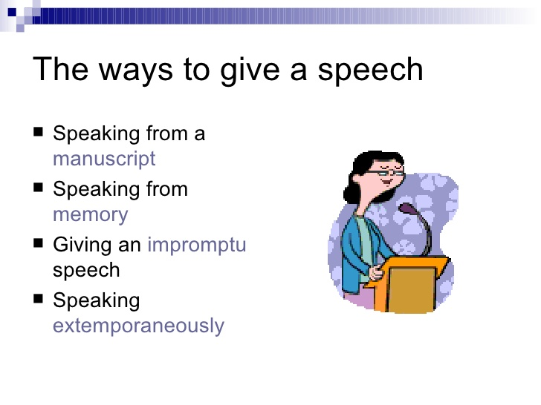
Choosing a Delivery Method
Speakers have several methods for delivering a message—ranging from spontaneous, off the-cuff remarks to speeches carefully planned, written, revised, and rehearsed.

Slide 14
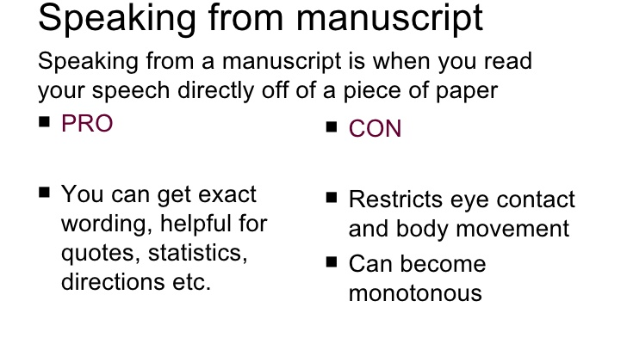

Slide 15
On some occasions, speakers have their entire speeches written, and they read the speech to the audience.
While it may be tempting to take this manuscript speech approach, it is not often a good idea.
Rarely can a speaker read a speech and manage to make it sound natural.
Too many speakers sound like they are reading, rather than speaking naturally to us.

Slide 16
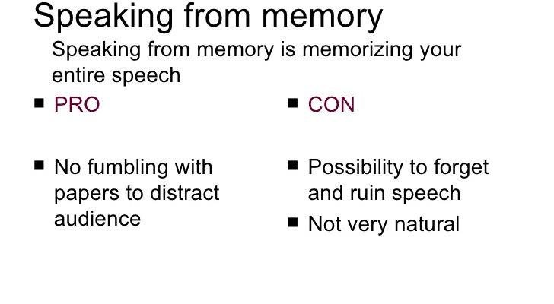

Slide 17
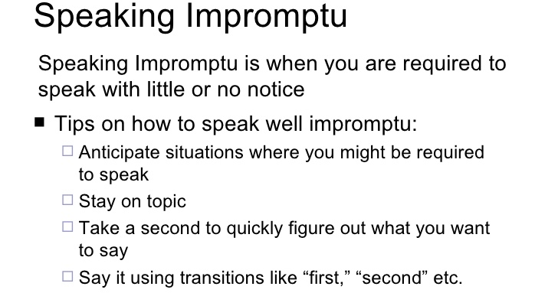

Slide 18
What do you do if you are asked to speak at the last minute?
If possible, take a few moments to jot down the major points you wish to make, an interesting way to
introduce your topic,
and some way of concluding.
Organizing your speech in this way will ensure that you make the important points.
Be sure to stop when you have made your points

Slide 19
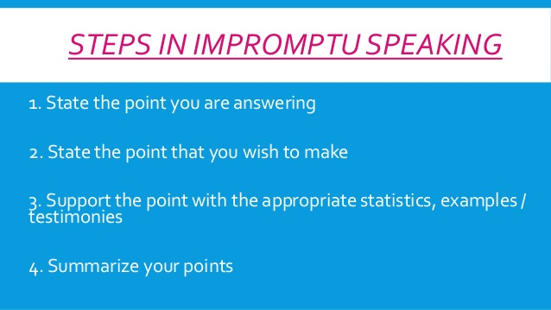

Slide 20
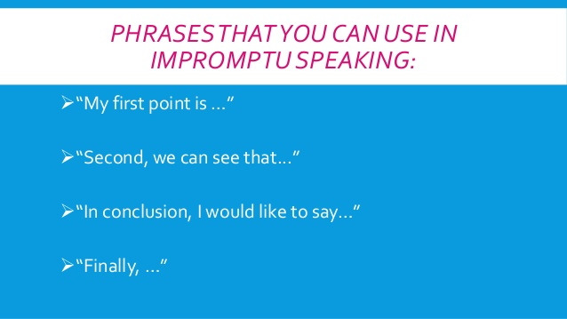

Slide 21
Extemporaneous
Extemporaneous speaking is a limited-preparation speech event based on research and original analysis.

Slide 22
Impromptu speaking involves delivering a message on the spur of the moment, as when someone is asked to “say a few words.” Extemporaneous speaking consists of delivering a speech in a conversational fashion using notes.
This is the style most speeches call for.

Slide 23
Extemporaneous speech
Speaking extemporaneously allows you
to be directly engaged, but well-prepared speaker.
An extemporaneous speech is written ahead of time, but only in outline form.; then, the speaker uses the outline as a guide.

Slide 24
Some extemporaneous speakers may include a few extra notes in the outline to help them remember,
particularly important points, statistics, or quotations,
But, the speech is neither written out in its entirety nor memorized.

Slide 25
By speaking extemporaneously, you will be able to
better engage your audience and
adapt your speech to their responses.

Slide 26
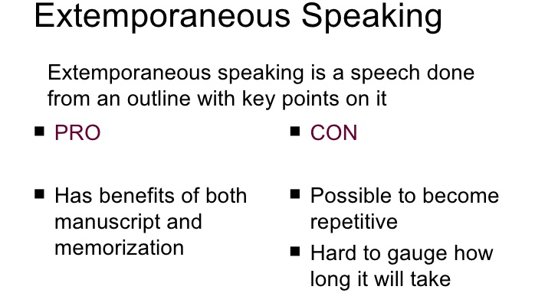

Slide 27
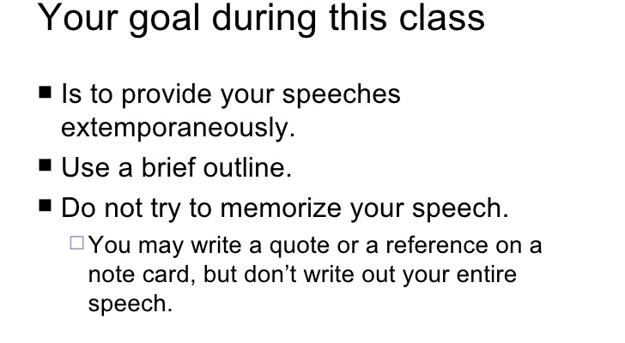

Slide 28
Note Cards/ Cue cards
Create note cards which have the main idea written on them.

Slide 29
Practicing your speech
After you have prepared your speaking outline and visual aids, you will need to practice your speech. Prepare your speech several times.
Initially, use your practice outline.
Always practice in the speaking voice you plan to use during your presentation rather than reading through your speech silently. Review your performance after practicing.

Slide 30
Use a clock or stopwatch to time the presentation. Compare the time to the time you've been allotted
Determine whether you need to shorten or lengthen your speech
Spoken aloud, you may discover that your signposts do not adequately signal your main points or that your supporting evidence requires another visual.
Refine the speech until you are satisfied with the content and length.

Slide 31
Handling presentation aids
1. Carefully plan when to use presentation aids
In your notes mark down when you are going to use them
Practice introducing yours aids so that you are comfortable with them.

Slide 32
2. Consider audience needs carefully
Practice your speech and figure out which aids do not help in gaining
audience attention,
understanding and retention of main ideas

Slide 33
3. Set up aids before speech
Make sure everything is where you want them to be
Check if all are working properly– test cords, electronic devises etc.

Slide 34
4. Reveal presentational aid only when talking about them
Reveal the portion you are discussing– for ppt you can custom animate them.
Use a blank slide when you’re idea you are talking about is not mentioned on the slides

Slide 35
Display presentational aid so that all the audience can see.
If the aid cannot be seen or heard it is a problem and it is frustrating for both speaker and audience
If possible practice in the ahead of time
If that is not possible arrive early, set up equipment and do a quick practice

Slide 36
6. Reference the presentational aid during the speech
Explain what audience will see in visuals, tell them what to look for
Use the turn-talk-touch method
When finished return to lectern

Slide 37
7. Talk to your audience not to the aid
Look at the aid occasionally
Maintain eye contact with audience.
Practice and resist the urge to look at the screen

Slide 38
https://catalogue.pearsoned.co.uk/assets/hip/gb/hip_gb_pearsonhighered/samplechapter/0205627870.pdf
http://www.engr.psu.edu/speaking/DELIVERY.html
http://catalog.flatworldknowledge.com/bookhub/reader/3795?e=wrench_1.0-ch15_s02

Slide 44
For example,
at an event like a business convention, a person may be asked to speak spontaneously as the surprise recipient of an award. Or a person may be asked to make a few comments at a community or university meeting. Making extensive comments in class can also be thought of as an impromptu speech. This type of speech is often difficult for a beginning speaker.

Slide 45
It is important to note that in a technical presentation you are expected to speak to the audience from your knowledge of your material and not rely on notes.
When a presenter relies on notes for their information this can have a negative impact on the presenter’s credibility because it implies to the audience that you don’t have a firm grasp on your content.
It is fine to briefly refer to a note card for precise information (statistics, quotes, etc.), but refer to that note card only when necessary and keep it out of sight otherwise. Ideally, you will not utilize notes at all.

Slide 46
generally prefer to hear from you directly, as if you are speaking from the heart. Engaging your
audience with direct address, including direct eye contact, is preferable to the more distanced
presentation that results from reading

